Slide 1
The kinship domain example from http://owl.cs.manchester.ac.uk/publications/talks-and-tutorials/fhkbtutorial/ extended with rules

Slide 2
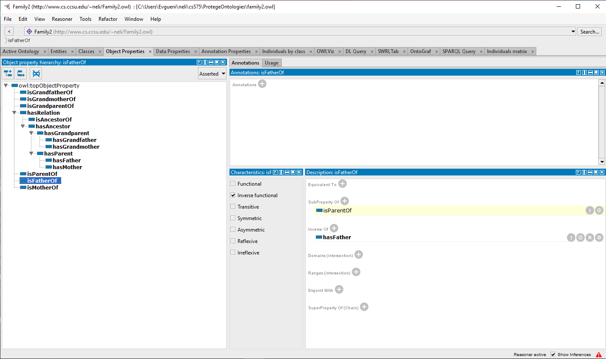
Describing properties

Slide 3
Create the A-box: add individuals and their respective mother and father

Slide 4
Run the reasoner (Pellet): see all derived relations for the selected individual

Slide 5
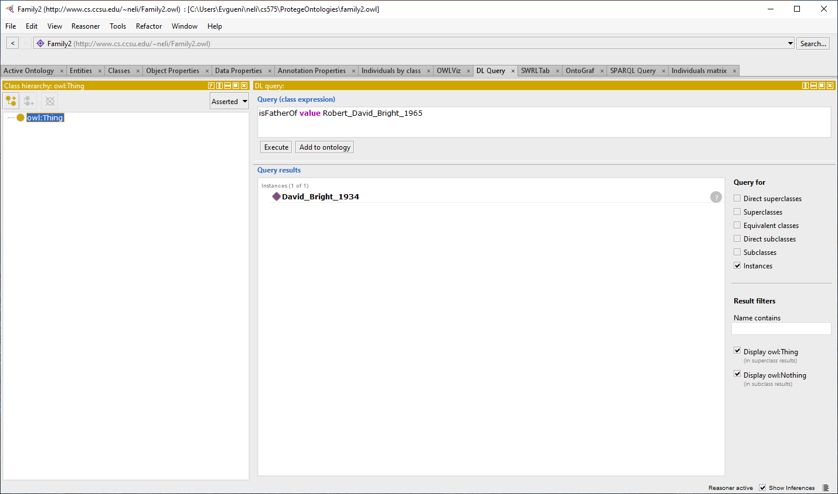
Execution of the queries “Whose father is David_Bright_1934?” and “Who is the father of Robert_David_Bright_1965?” Note entailed fact that D_B_1934 isFatherOf R_D_B_1965 – we have defined only hasFather relation but stated that isFatherOf is its inverse.

Slide 6
Other inferences for R_D_B_1965 reflecting property hierarchy – sub-property implies super-property

Slide 7
Introducing ancestors and descendants: add new properties (hasRelation – symmetric; hasAncesstor – transitive; isAncesstorOf – inverse of hasAncesstor)

Slide 8
Inferred property hierarchy

Slide 9
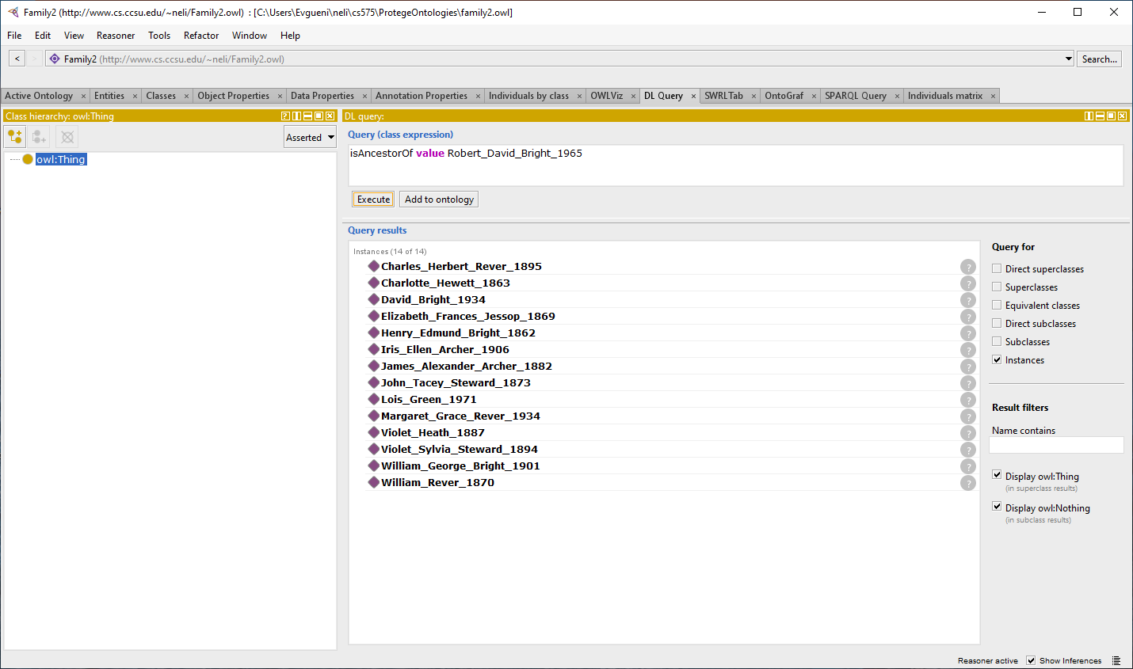
Execution of the queries “Who are the descendants of W_G_B_1901? and “Who are the ancestors of Robert_David_Bright_1965?”

Slide 10
Who are the children and the father of D_B_1934?

Slide 11
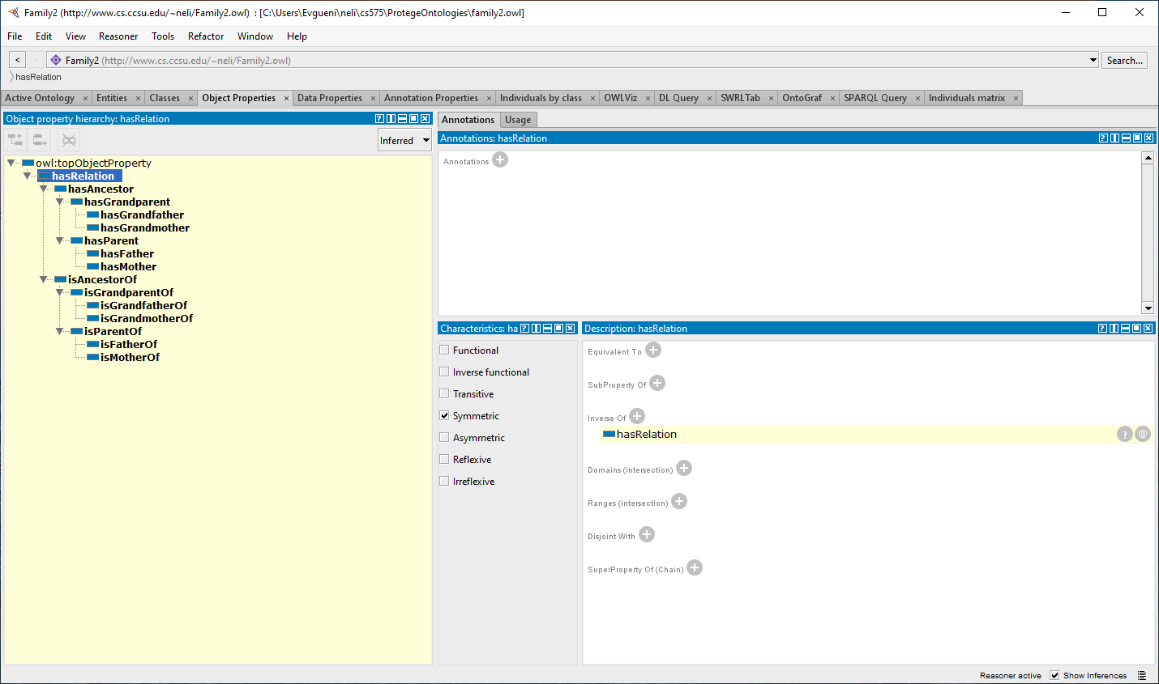
Adding grandparents properties (hasGrandparent, hasGrandmother, hasGrandfather and their inverses): inserted and inferred hierarchies

Slide 12
Property chains for grandparents, great-grandparents, etc. reflect limited transitivity

Slide 13
All inferred relations are also explicitly associated with a selected individual (only part of these relations shown here)

Slide 14
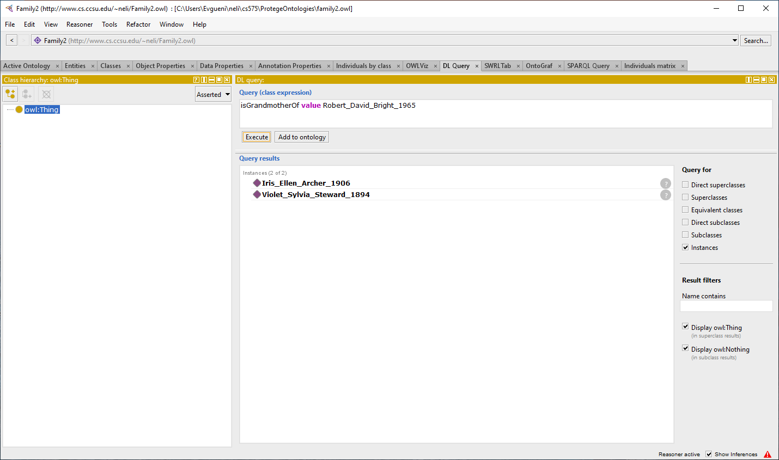
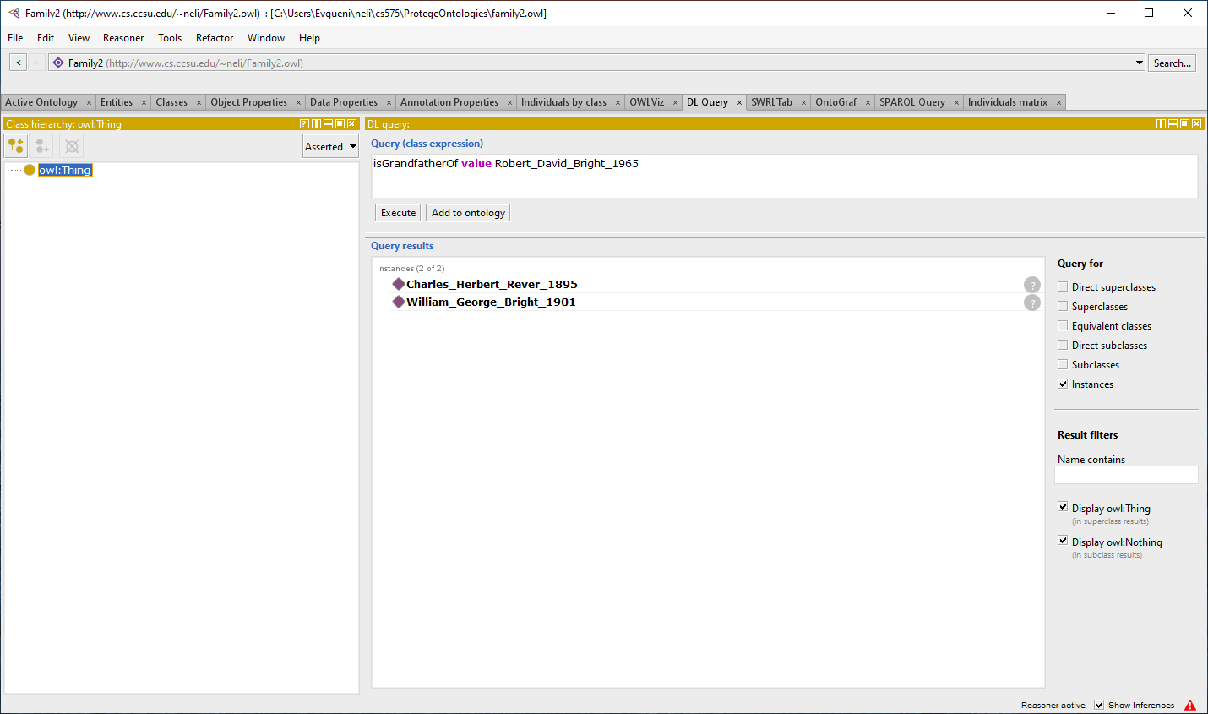
Who are the grandparents/grandfathers/grandmothers of R_D_B_1965?

Slide 15
Creating classes to represent groups of objects in the kinship domain (Person, Sex, Man, Woman).This would allow us to describe the objects in terms of their type. We can put them all under the class DomainEntity to “enclose” the domain. Here is the description of the Person class. Note that restrictions (Subclass Of) on classes mean that we know something about members of that class; Equivalent To means iff statements (i.e. axioms).

Slide 16
hasSex property connects an object of type Person to an object of type Sex

Slide 17
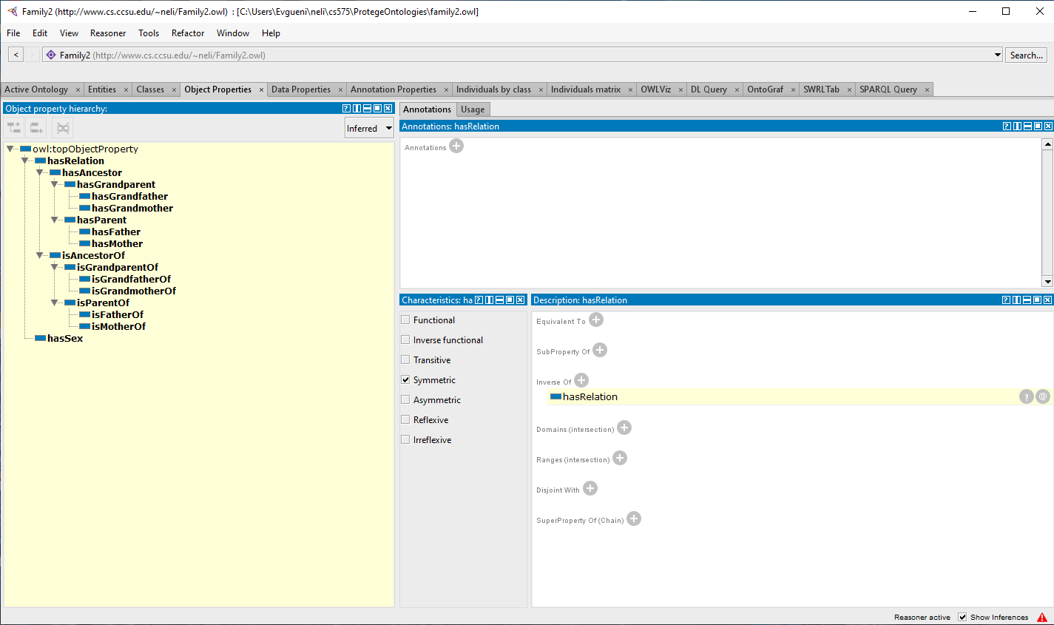
Inferred hierarchies

Slide 18
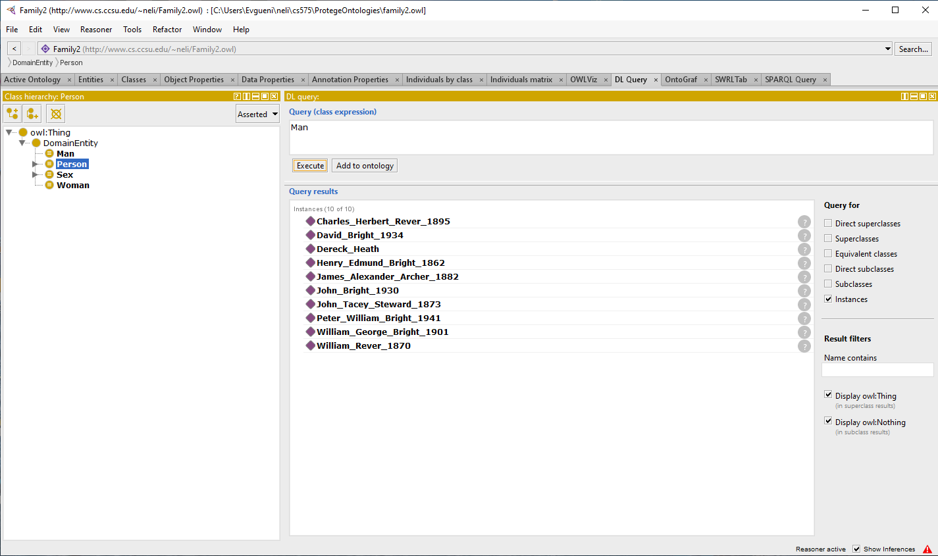
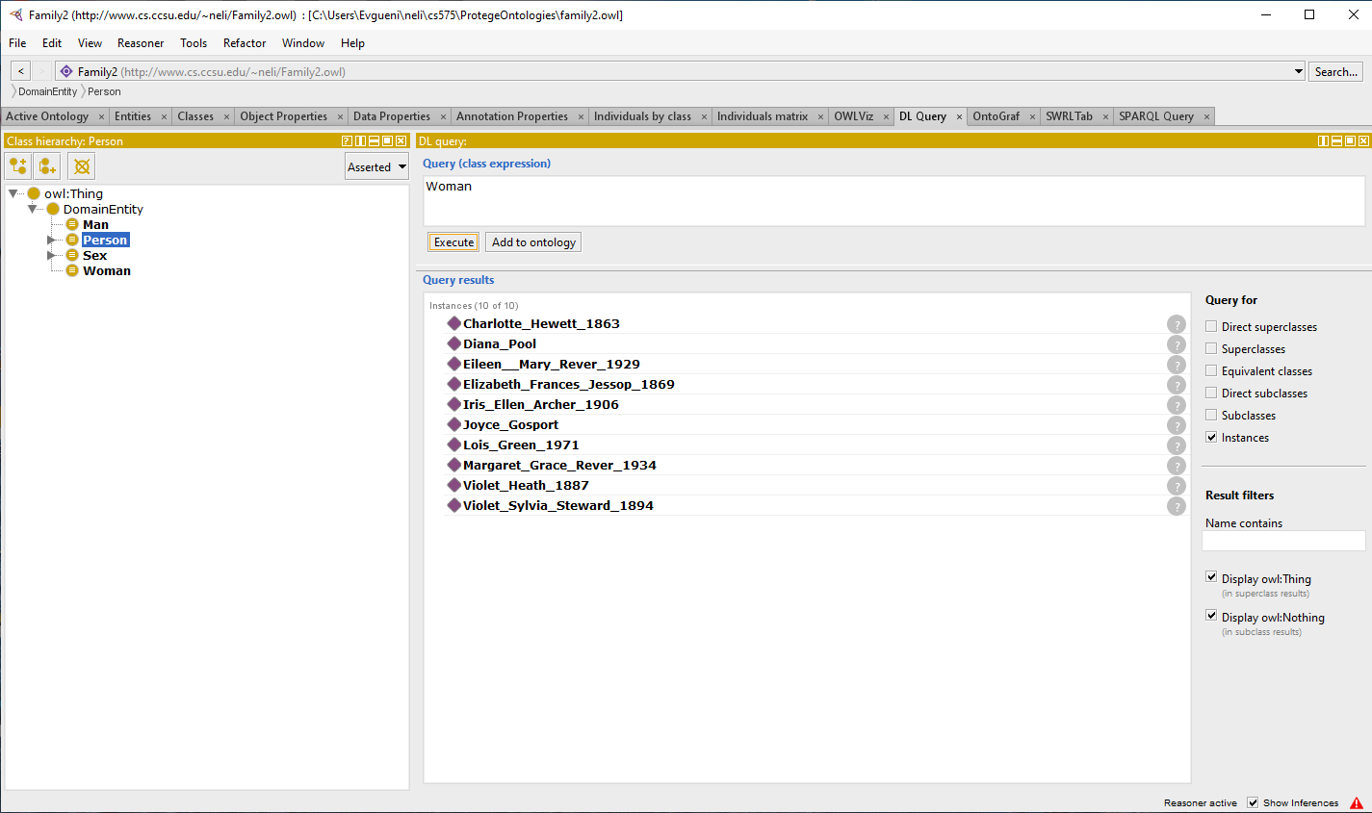
Who is a Person, Man, Woman? How domains and ranges of hasMother/hasFather drive inferences? (31 Person; 10 Woman; 10 Man?)

Slide 19
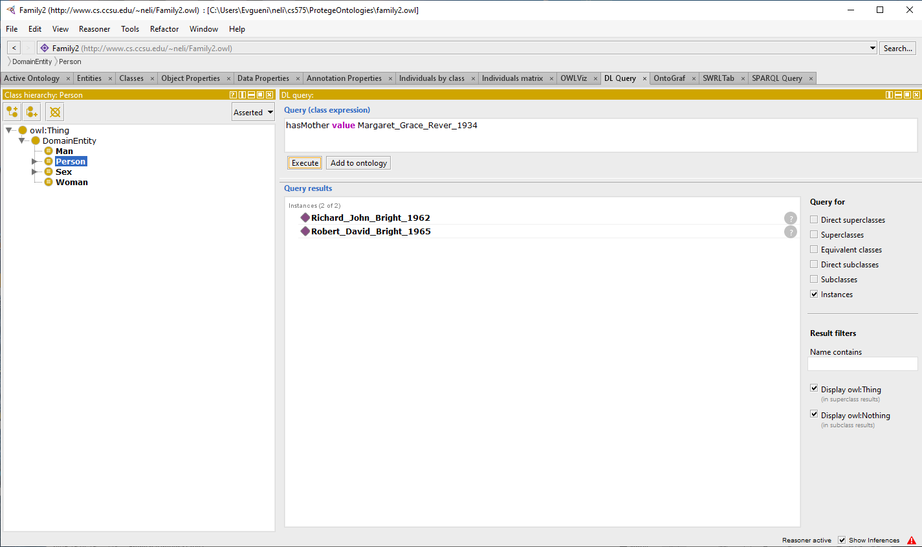
Who has a mother? Whose mother is M_G_R_1934?

Slide 20
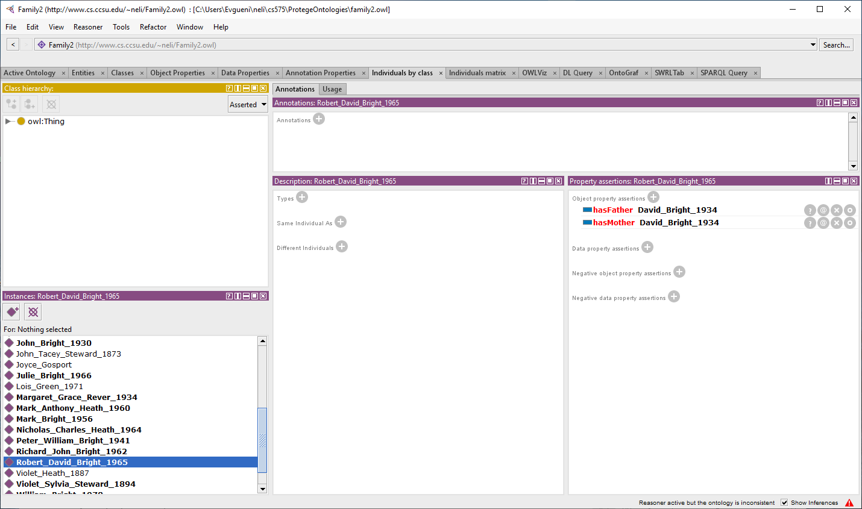
Inconsistencies: a stated or derived fact cannot be added to the Abox, because it contradicts other facts that are already there. Example: declare R_D_B_1965 hasMother David_Bright_1934

Slide 21
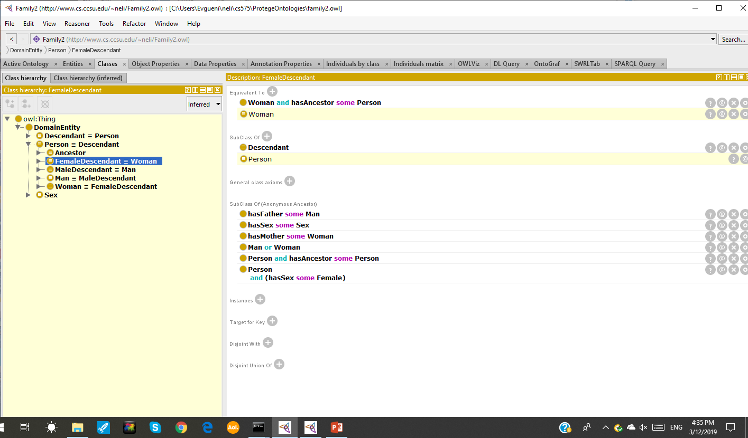
Adding classes for Ancestors/Descendants (before/after reasoner). Note that the reasoner inferred that Person and Descendant classes are equivalent (have the same members) – same for subclasses.

Slide 22
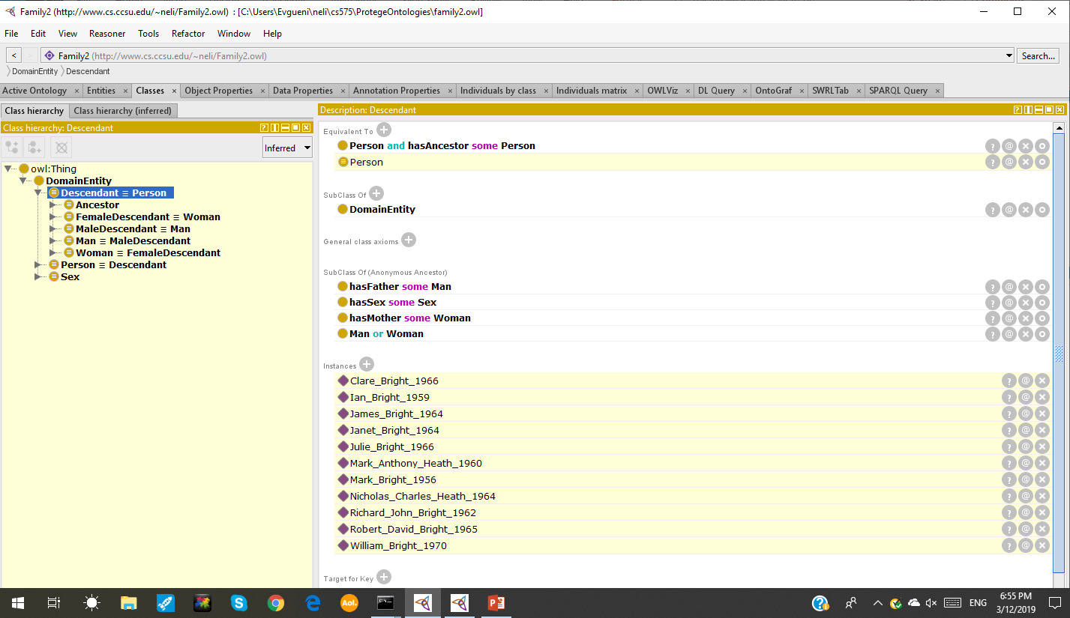
Defining domain and range of the properties makes a difference (compare with the next slide)

Slide 23
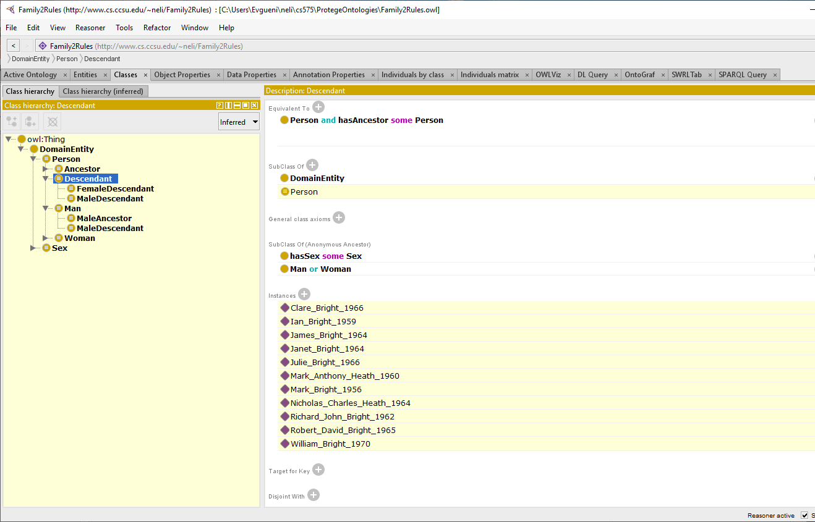
Defining domain and range of the properties makes a difference. Answers to query about descendants will be different.

Slide 24
Introducing sisterhood/brotherhood: the rules approach

Slide 25
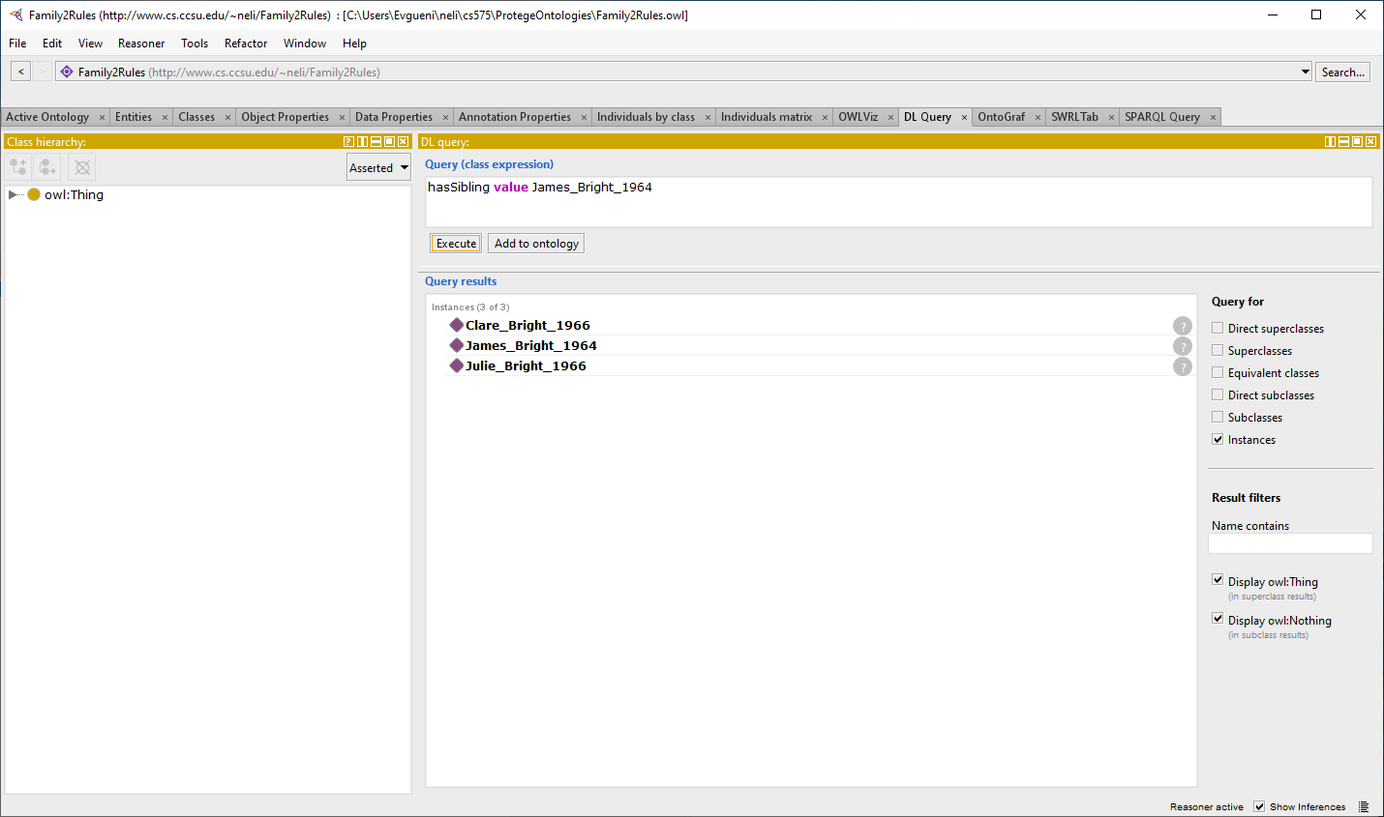
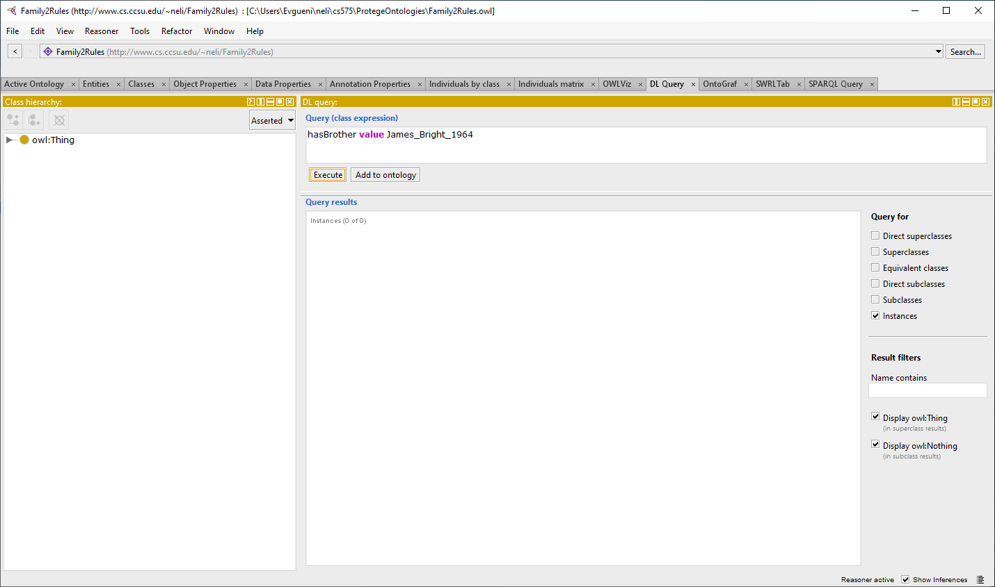
The missing part: sex not implied for all individuals. J_B_1964 has siblings, but no brother? The reason – Woman/Man can be inferred for some individuals only. Defining the sex property for individuals seems the easiest way to proceed.

Slide 26
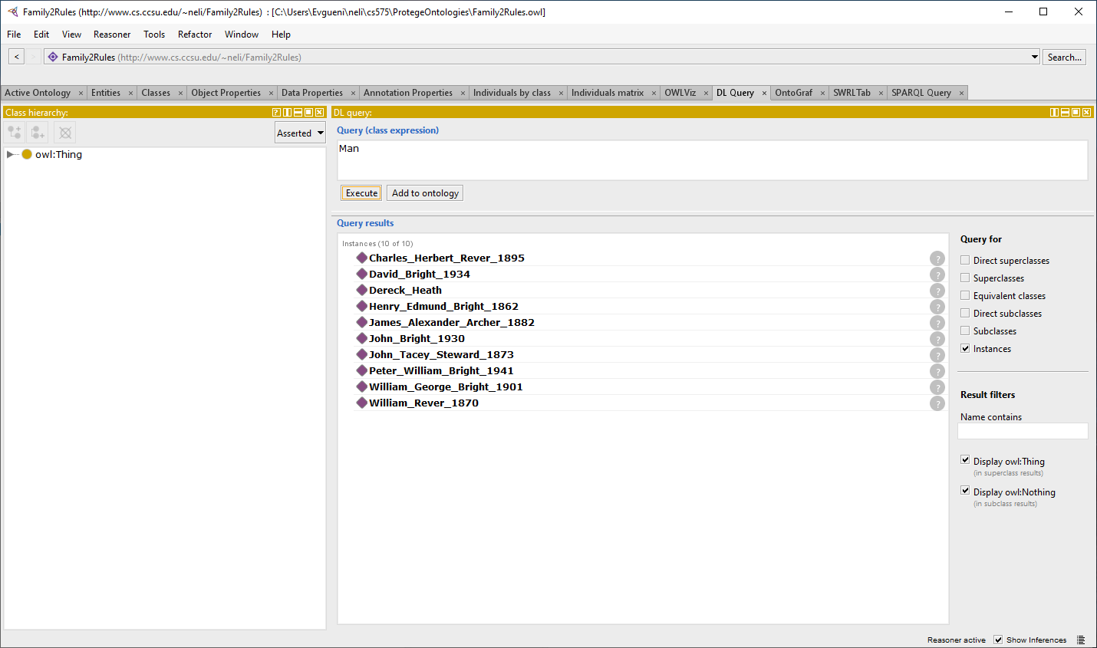
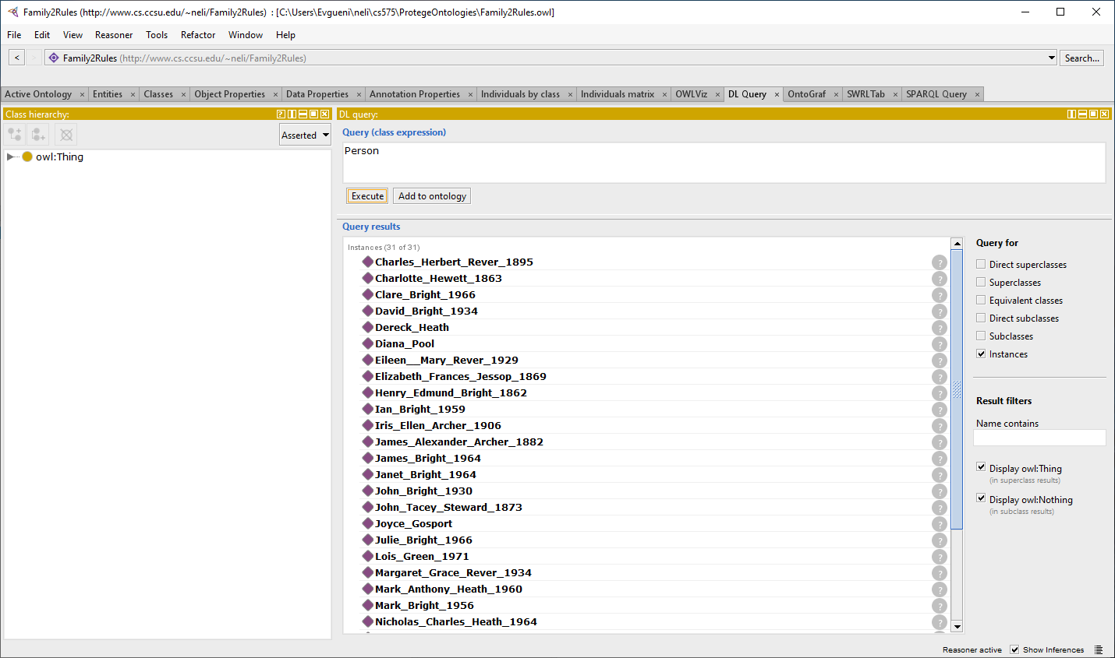
Man/Woman identified so far without sex property explicitly defined for all individuals (Person shown for comparison)

Slide 27
What is known for individuals so far?

Slide 28
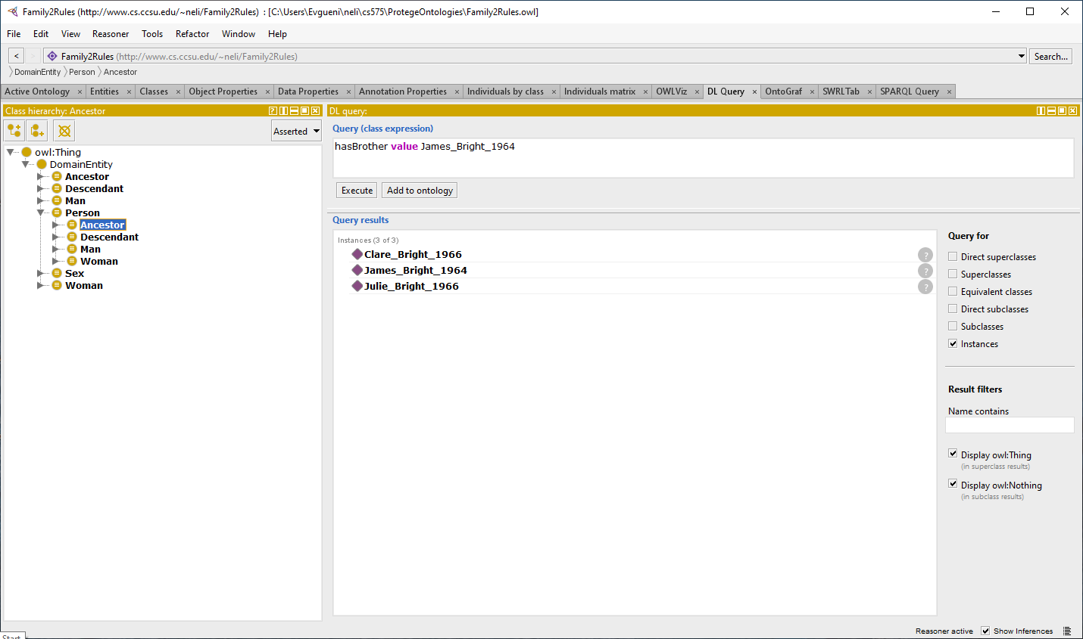
Brotherhood/Sisterhood complete with sex defined for all individuals

Slide 29
Another query

Slide 30
How to define half-siblings: the role of OWA
Here are the rules for hasHalfSibling:
hasFather(?x, ?y) ^ hasFather(?v, ?w) ^ hasMother(?x, ?z) ^ hasMother(?v, ?z) -> hasHalfSibling(?x, ?v)
hasFather(?x, ?y) ^ hasFather(?v, ?y) ^ hasMother(?x, ?z) ^ hasMother(?v, ?w) -> hasHalfSibling(?x, ?v)
This rules will NOT work correctly, because although we have stated that all individuals are different, we still need to say that ?y ≠ ?w (in the first rule) and ?z ≠ ?w (in the second rule).
The reason: the Open World Assumption (OWA), which states that if we do not explicitly state something, then it is considered UNKNOWN. The unification procedure, therefore, suggests that ?y = ?w and ?z = ?w, which results in these rules acting the same way as the rule for hasSibling.
Why OWA? The guiding principle on the web is that “Anyone can say Anything about Any topic” – theso-called AAA slogan. The OWA is a consequence of it. In our case, we are not explicitly stating that two variables are different, therefore they can be the same.

Slide 31
More rules added

Slide 32
More interesting query: Who are the wives of WB1970? Notice that hasWife is derived by rule 15, and then isWifeOf is derived by the reasoner as an inverse property of hasWife.

Slide 33
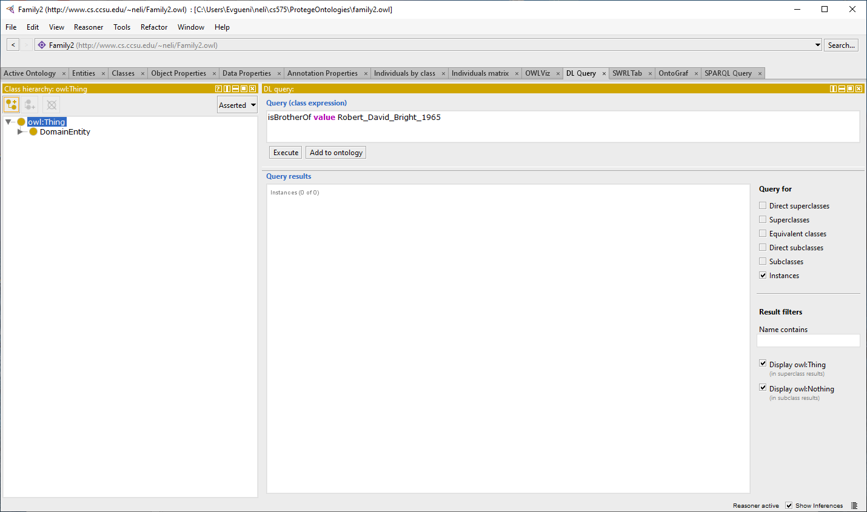
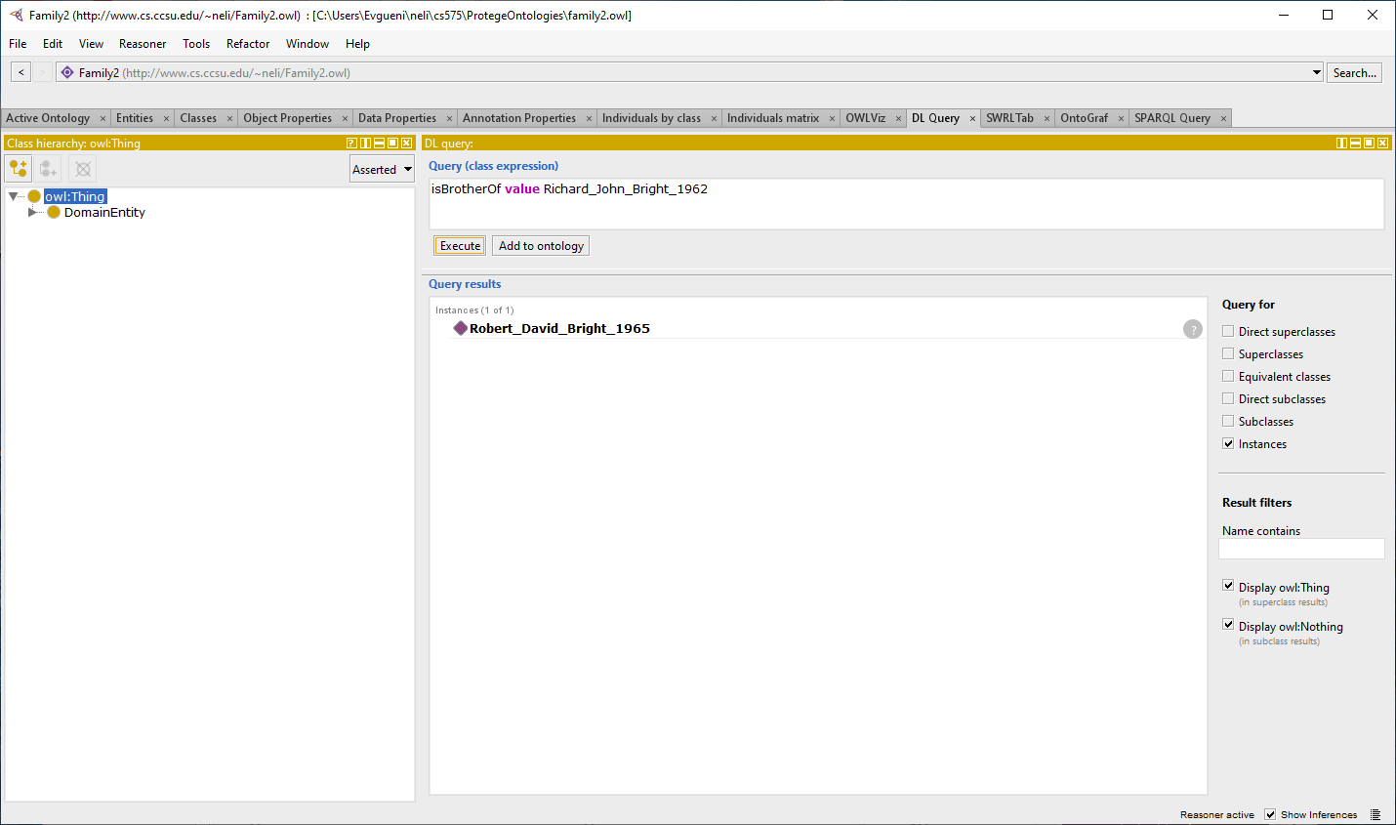
Back to OWL version of the family ontology
Notice that sisterhood/brotherhood is derived by the corresponding SWRL rules. We cannot do this in Protégé by means of OWL 2 in purely DLs fashion, because we cannot say Man(x) and hasSibling(x, y) implies hasBrother(y). To handle this, we will explicitly define the sibling relationships by stating, for example, that “x isBrotherOf y” and “z isSisterOf y”. But, if it is not defined both ways, we will get a wrong result:

Slide 34
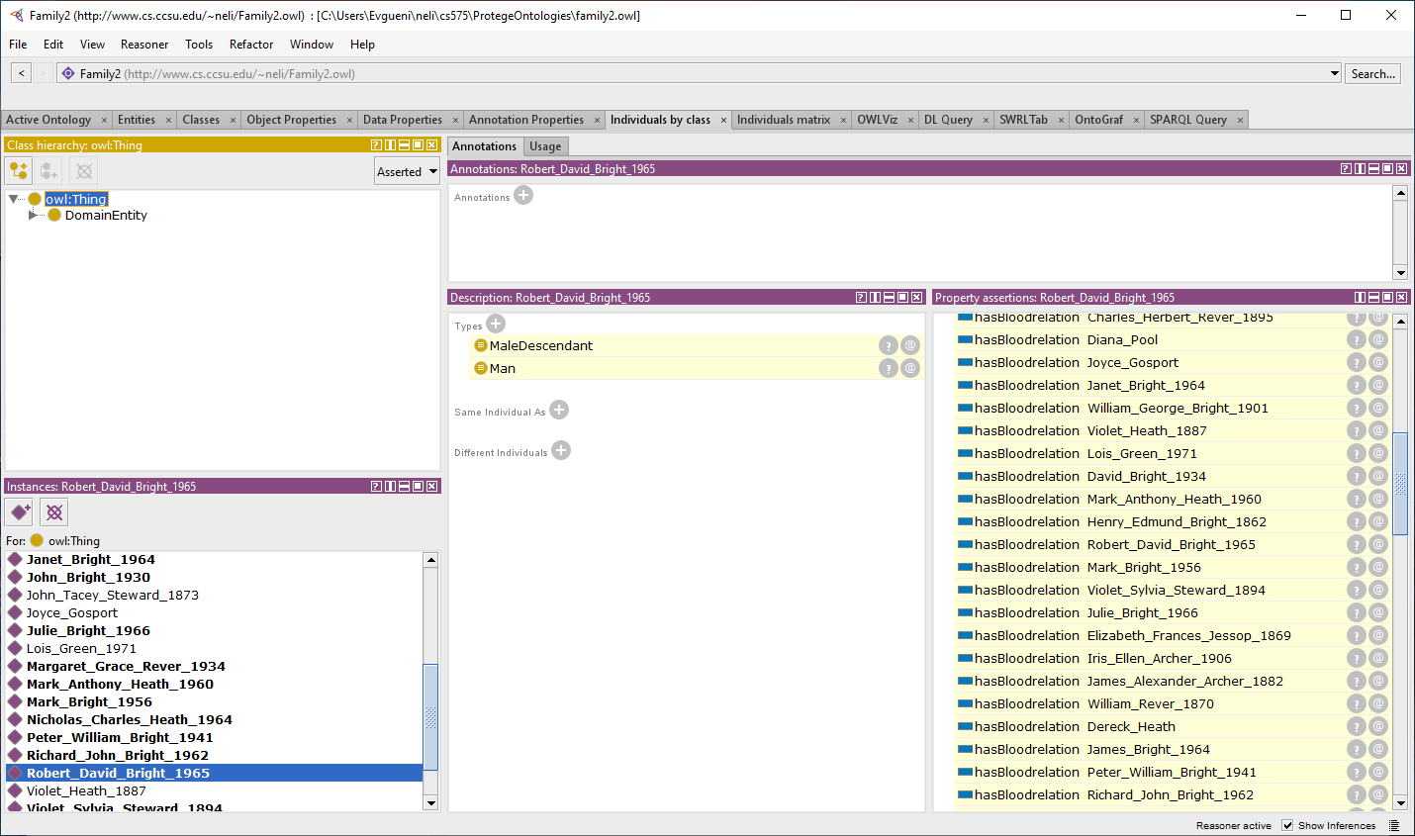
How much is inferred at this point by the reasoner for a named individual? Here is a small sample of inferred facts:

